Slide 1
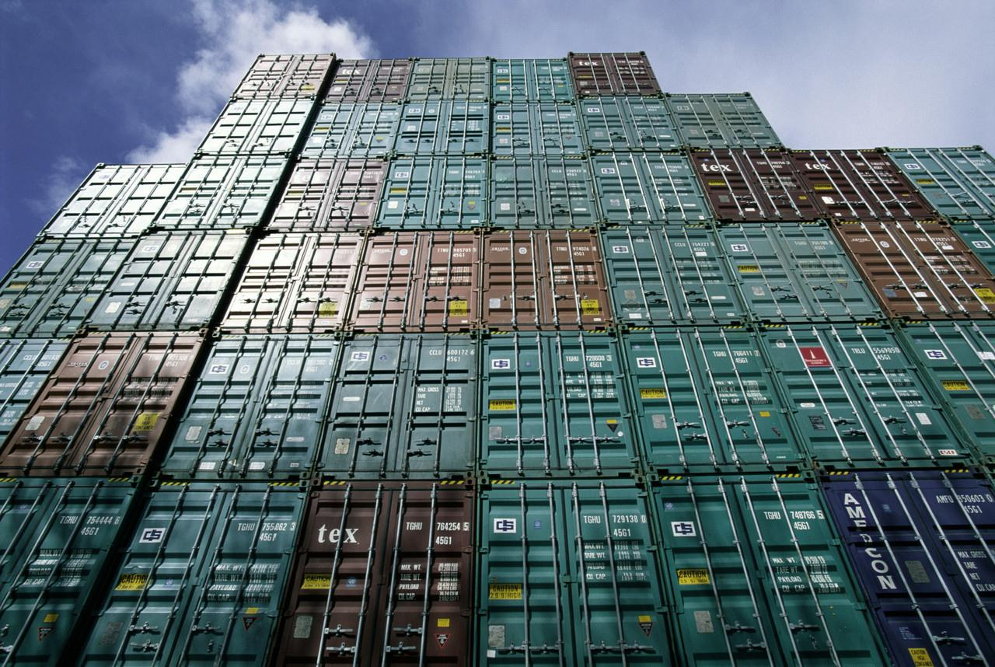
The Generalized System of Preferences (GSP) Program
Naomi Freeman
Office of the U.S. Trade Representative
Executive Office of the President
August 2016

Slide 2
Presentation Summary
Overview of the U.S. GSP Program
Brazil GSP exports to the U.S.
The MTB process and other export program issues

Slide 3
GSP Program
Provides duty-free treatment for about 3,500 products from Brazil and 121 other countries
$17.7 billion in total U.S. GSP imports (2015)
GSP program currently authorized through December 2017
Previous expirations have led to extended lapses, with duties required for shipments.
Renewals have been retroactive
with duties paid refunded
3

Slide 4
Country graduation—Canada (2015) & EU (2014) have graduated Brazil

Slide 5
Country graduation--US
World Bank High Income (not Upper Middle Income like EU) 2015: $12,475
(Brazil per capita 2015: $9,850)
Recent example: Uruguay graduation proclaimed 9/15, taking effect 1/17

Slide 6
Country Practice Criteria include:
Expropriation/Arbitral Awards
Taking steps to protect internationally recognized worker rights, including stopping child labor
Market Access for US exports
US Intellectual Property Rights protected
Full description and list in Guidebook
https://ustr.gov/sites/default/files/The%20GSP%20Guidebook.pdf

Slide 7
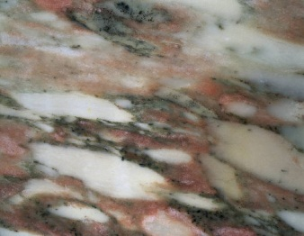
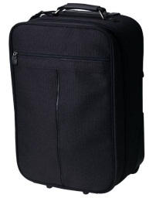
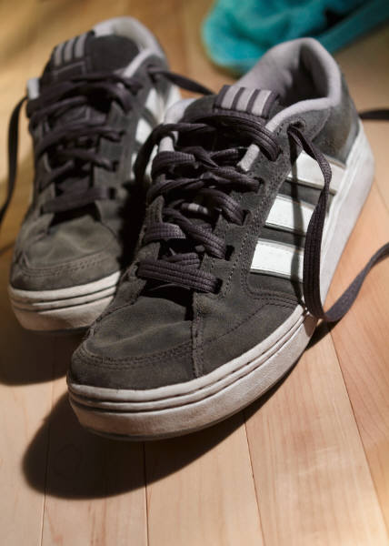
GSP Program: Eligible Products
Eligible
Many manufactured items & inputs
Jewelry
Some agricultural products
Many Chemicals
Many Minerals
Certain Carpets
Ineligible
Most textiles & apparel
Watches
Footwear
Some gloves & leather goods
Many agricultural products

Slide 8
Top U.S. GSP Imports (from World) 2015

Slide 9
How many HTS lines are eligible for GSP duty-free treatment?
9
Notes:
Updated 12/11

Slide 10
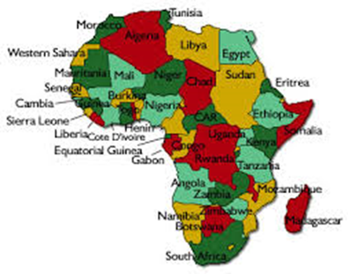
LDBDCs
LDBDCs eligible to ship more lines under GSP (A+ in HTS); but most LDBDCs don’t have resources to export as much as larger exporters. Includes much of Africa; a few countries in Asia; only LDBDC in the Americas is Haiti

Slide 11
U.S. and Brazil: 2015 Trade
U.S. goods imports from Brazil: $ 27 billion
GSP imports from Brazil: $1.9 billion (7% of U.S. imports from Brazil, but 11% of total GSP imports from all suppliers). Third largest exporter under GSP after India and Thailand
Brazil is excluded from GSP for products for which Brazil is very competitive--CNLs
11
Notes:
Update 5/12

Slide 12
How to Qualify for Duty-Free Treatment under GSP
Must be a GSP-eligible product
Must be a product of Brazil
If using non-Brazilian inputs, local content & processing must be ≥ 35% of the value
Must import directly into the U.S. without entering commerce of another country
Benefit must be claimed by importer
Keep production/accounting records to assist importer to verify GSP claim
12

Slide 13
Is my product eligible for duty-free treatment under GSP?
The easiest way to find out is to go to:
List of GSP-eligible products at:
http://dataweb.usitc.gov/scripts/tariff_current.asp
https://ustr.gov/issue-areas/trade-development/preference-programs/generalized-system-preferences-gsp/gsp-program-i-0

Slide 14
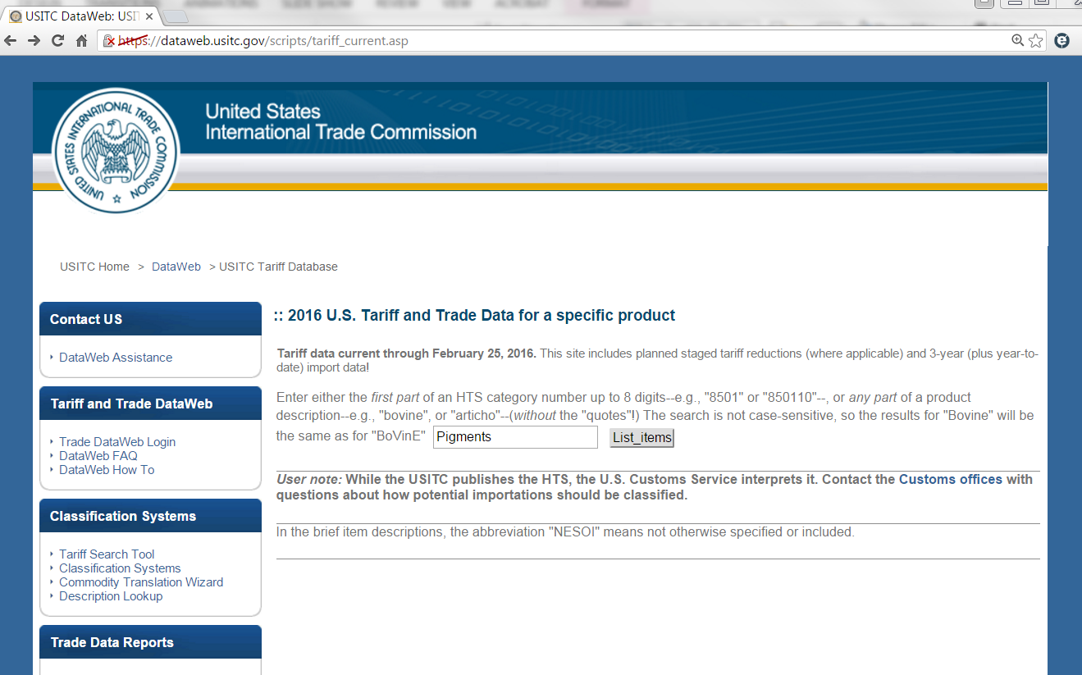
Go to: http://dataweb.usitc.gov/scripts/tariff_current.asp
Pigments
2. Click the “List items” button
1. Type the name of
your product

Slide 15
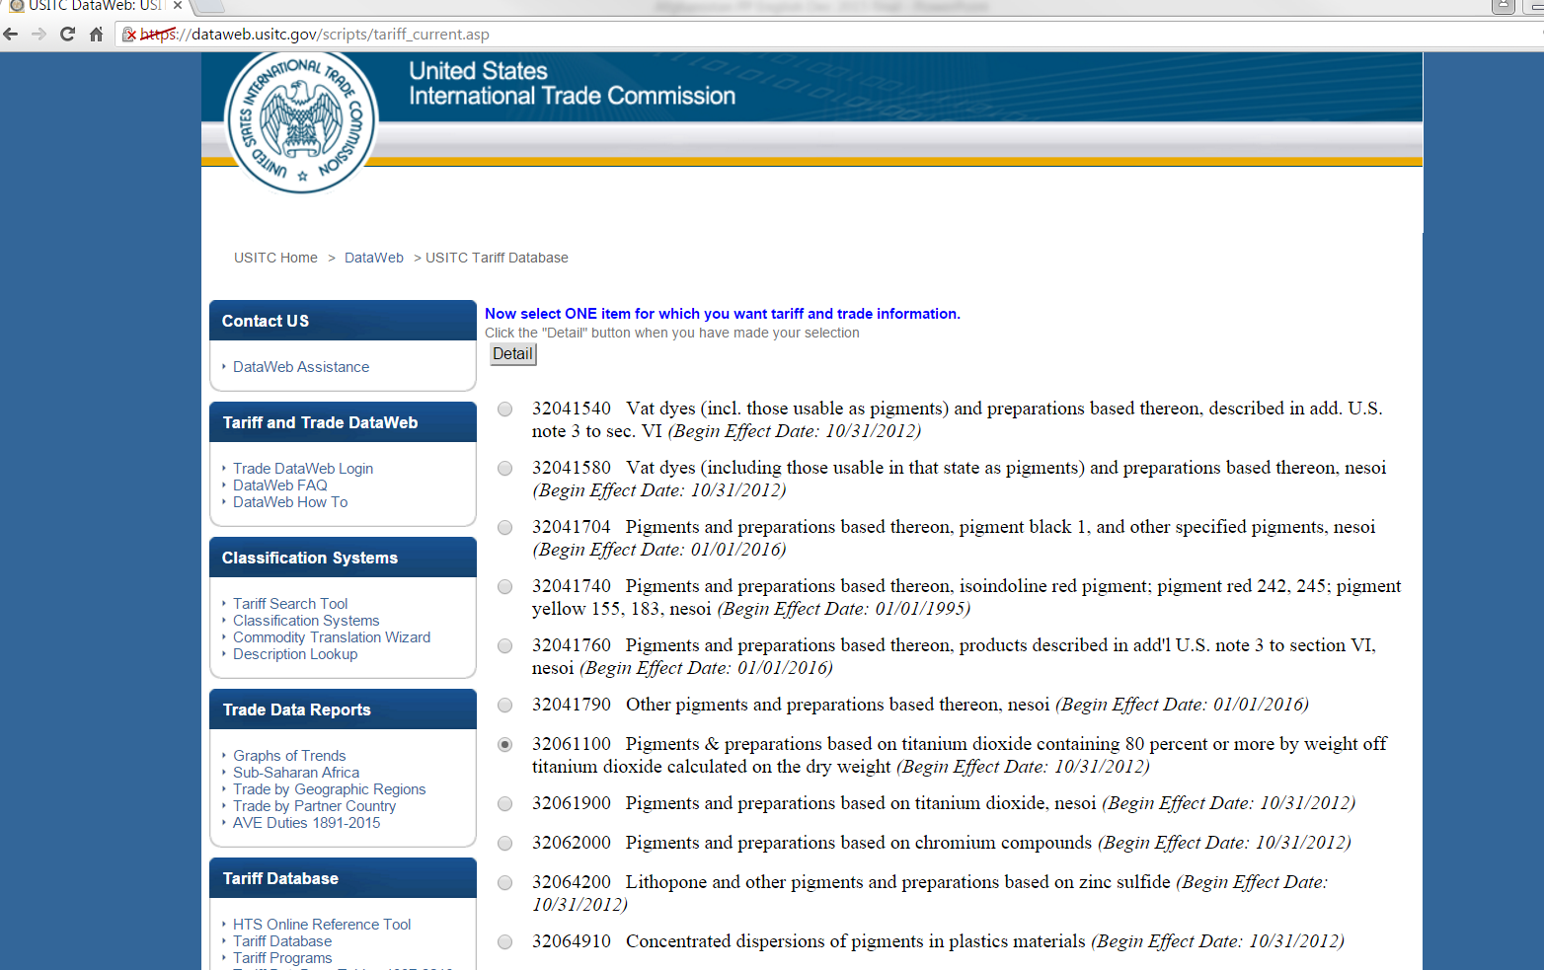
2. Click the “Detail” button
1. Choose your product from the list

Slide 16
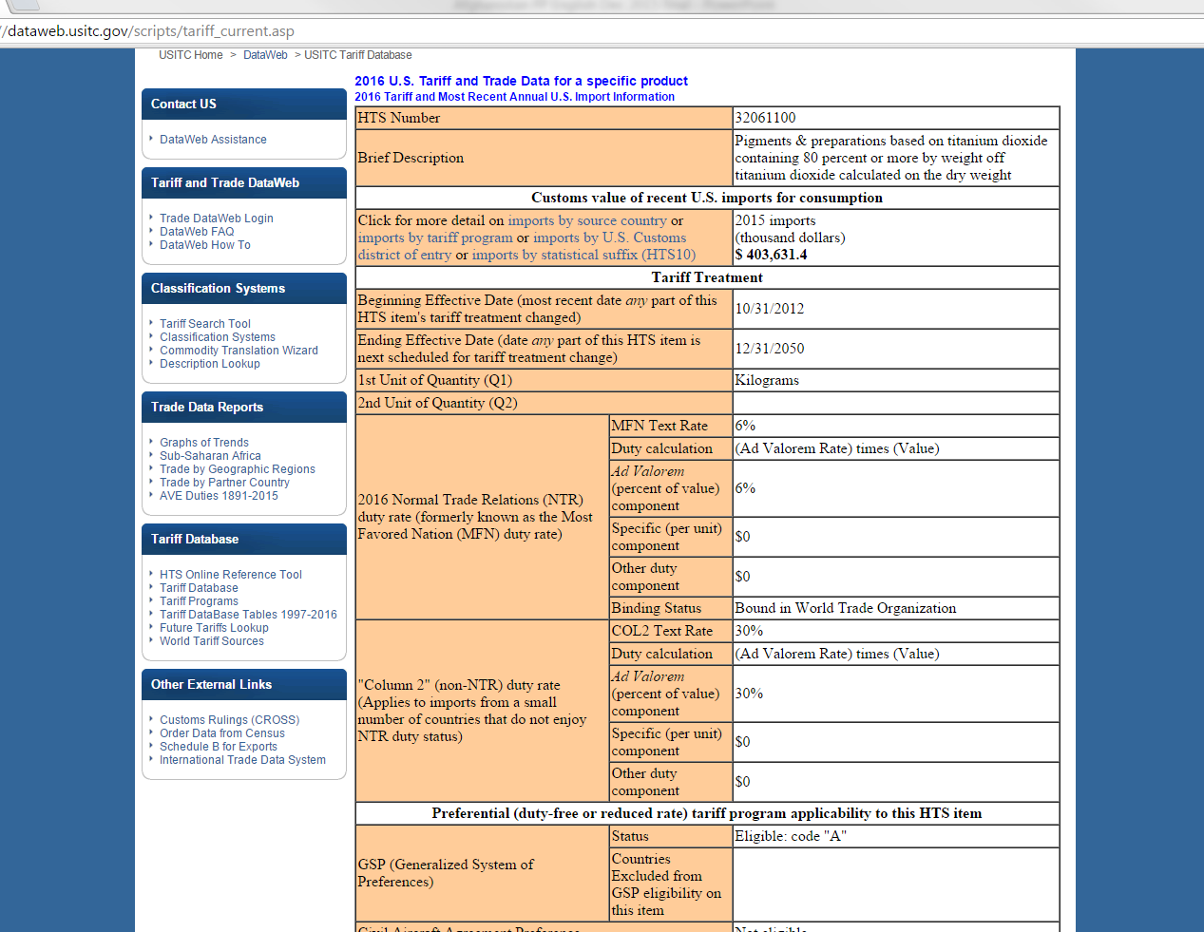
Check if code “A” is listed for your product; if A*, check excluded countries just below
√

Slide 17
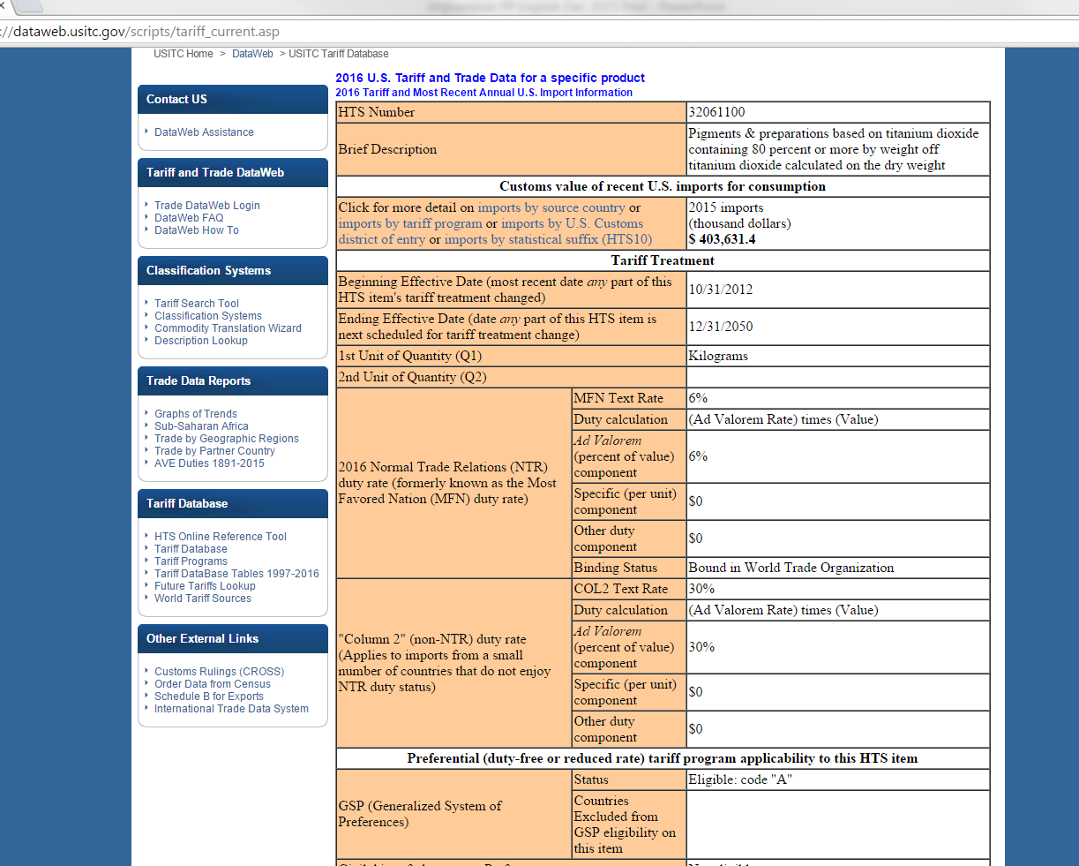
More detail can be found by clicking on the links here.
For example, click on “imports by source country”

Slide 18
GSP Petition Process to Add New Products
Product must not be excluded by statute (e.g., apparel)
Submit petition during Annual Review (next review just announced)
Provide the information required by the regulations by October 4, 2016

Slide 19
Competitive Need Limitations
There are two different measures for CNLs: TOTAL (not just GSP) U.S. imports of a particular product exceed (1) 50 percent of the value of total U.S. imports of that product; or (2) the dollar‐value limit which is $175 million for 2016 (increasing by $5 million annually). Excluded by HTS line, not by sector (as EU does).

Slide 20
Petition process for CNL waivers for non-LDBDCs
Due to timing problem, full year import statistics aren’t available when petition must be filed (December 2, 2016). If in doubt whether Brazil exports might reach 50% of imports or the dollar value for the year ($175 million for 2016), file the waiver petition; it can be withdrawn if not needed.

Slide 21
CNL Waiver Revocation
Since 2006 GSP renewal, CNL waivers in effect for 5 years or more are revoked if total imports from a country are 150% of Dollar CNL for that year OR 75% of world imports

Slide 22
“Miscellaneous Tariff Bill” (MTB) duty suspension process
Provides 3 years of duty-free or reduced duty rate (up to $500,000 estimated value).
Not applicable if any domestic opposition.
Product is described in detail within an 8 digit HTS number (examples follow)

Slide 23
Duty suspension “MTBs”
Legal authority had lapsed since 2012;
60 day petition period beginning October 15, 2016
Second 60 day petition period beginning October 15, 2019
Law provides for two 3 year cycles (likely to be 2018-2020) and (2021-2023)

Slide 24
Who Can File a Petition?
A “member of the public” who can demonstrate that they are likely to use, or benefit directly from the use of, the article that is the subject of the petition
A likely beneficiary is generally the importer of record or a U.S. manufacturer that uses the imported article
Notes:
The legislation requires that the person filing the petition be a likely beneficiary of the duty suspension or reduction. A likely beneficiary is someone who is likely to use, or directly benefit from the use of, the article that is the subject of the petition. In general, a likely beneficiary is the importer of record or a manufacturer that used the imported article.

Slide 25
Requirements for Duty Suspensions
No opposition from a domestic producer of the product
Revenue loss must be less than $500,000 per year for each product
Petitioner must certify that the duty suspension is available to all importers
Product must be described in a way that is sufficiently clear to be administered by US Customs and Border Protection
Notes:
The requirement for duty suspensions and reductions are similar to what they were under the old MTB system, so if you’ve been involved in MTBs in the past you will be familiar with these requirements. First, if there is a domestic producer of the product who objects to the petition, it would not be recommended to Congress. Second, the revenue loss each year must be less than $500,000. If a full duty suspension for your product would cause the revenue loss to be greater than $500,000 per year, you could request a duty reduction rather than a full suspension of the duty to get under the $500,000 limit. The petitioner must also certify that the duty suspension is available to all importers. So if the product is covered by a patent or other intellectual property so that only the petitioner or its licensees can import the product, the petitioner couldn’t certify that the duty suspension would be available to all importers. You must also be able to describe your product in a way that a Customs officer can clearly tell that the product you are importing is the product described in the temporary duty suspension provision. The article description should describe the physical characteristics of the product at the time of importation and avoid specifying what the product will be used for after importation.

Slide 26
Petitions submitted to US International Trade Commission
ITC reviews for accurate description and ability to implement by US Customs

Slide 27
ITC Timeline
No later than October 15, 2016 – opening of 60 day window for submitting petitions
Mid-January, 2017 – Official publication of petitions on USITC’s website and start of 45-day public comment period
Mid-June, 2017 – USITC delivers preliminary report to Congress
Mid-August, 2017 – USITC delivers final report to Congress
Notes:
The legislation requires that Commission begin accepting petitions for duty suspensions no later than October 15, 2016. Petitioners will have 60 days to file their petitions. In mid-January, the Commission will issue a Federal Register notice announcing the official publication of the petitions that we received and the beginning of the 45-day window for public comment on the petitions. In mid-June, the Commission will deliver our preliminary report to the House Ways and Means Committee and the Senate Finance Committee. The preliminary report will be public and will allow members of Congress to begin considering the petitions that the Commission recommends. By mid-August, the Commission will provide its final report to Congress. After that, it’s all in Congress’s hands. Our understanding is that the Committees will introduce an omnibus tariff bill that includes the products recommended for duty suspensions by the Commission. Congress can delete products if they wish, but they are not able to add any products to the bill. The decision to enact the temporary duty suspensions and when they will be effective is all up to Congress, not the USITC.

Slide 28
ITC Issues Public Report to Congress
Analysis regarding products that meet the MTB standards, including that there is no domestic opposition

Slide 29
Congressional Action
The Ways and Means Committee examines the ITC’s recommendations and drafts MTB proposal. They can exclude products from the final proposal, but cannot add products that were not recommended by the ITC. Congress would then consider the MTB within existing rules. Must pass both Houses of Congress and be signed by President

Slide 30
Examples of prior MTB based provisions in HTS heading 9902
Synthetic filament yarn (other than sewing thread) not put up for retail sale, single, of decitex sizes of 23 to 850, with from 4 through 68 filaments, untwisted, of nylon or other polyamides, containing 10 percent or more by weight of nylon 12 (provided for in subheading 5402.45.90)
Ink-jet textile printing machinery (provided for in subheading 8443.19.20)
Textile printing machinery (provided for in subheading 8443.19.20)
D-Mannose (CAS No. 3458-28-4) (provided for in subheading 2940.00.60)
Benzamide, N methyl-2-[[3-[(1E)-2-(2-pyridinyl)ethenyl]- 1H-indazol-6-yl)thio]- (CAS No. 319460-85-0) (provided for in subheading 2933.99.79

Slide 31
Brazil’s Exports to U.S.
No program claimed (including MFN/NTR duty free): $25.1 billion
GSP: $1.9 billion
Civil Aviation claims: $30 million
Pharmaceutical list: $11 million
Dyes list: $49,000

Slide 32
For Further Information
GSP General Information:
U.S. Department of Homeland Security: Customs and Border Protection (CBP):
https://ustr.gov/issue-areas/trade-development/preference-programs/generalized-system-preference-gsp
http://www.cbp.gov and
https://www.cbp.gov/trade
32

Slide 33
For Further Information
U.S. Tariff Schedule:
U.S. Tariff Databases:
http://usitc.gov/tata/hts/bychapter/index.htm
See esp. General Note 4.
http://www.usitc.gov/tariff_affairs/tariff_databases.htm
33

Slide 34
For Further Information
U.S Consumer Product Safety Commission:
http://www.cpsc.gov/businfo/faq.html
htps://www.cbp.gov/trade/rulings
Customs and Border Protection Rulings

Slide 35
For Further Information
U.S. Food and Drug Administration:
Questions on GSP?
http://www.fda.gov/ForIndustry/FDABasicsforIndustry/default.htm
USTR contact: gsp@ustr.eop.gov or + 1-202-395-2974

Slide 36
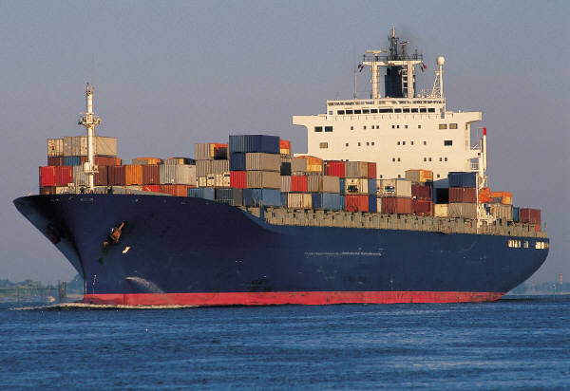
Thank you!

